Slide 1


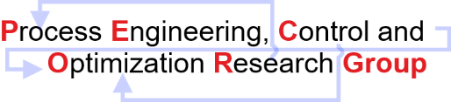
Artificial Neural Network
Model
Discipline of Chemical Engineering,
Indian Institute of Technology Gandhinagar,
Palaj, Gujarat – 382055
India

Slide 2
Artificial Neural Network
Forward Feature Selection Algorithm.
Start with the empty feature set.
Train ANN model or Random Forest Classifier for each remaining feature.
Estimate the accuracy of adding each feature.
Select the feature that gives the maximum accuracy.
Repeat steps 3-5 and stop when there is no significant improvement.
Before running into the forward feature selection algorithm, an analysis of whether the training of a neural network is stable for a particular batch size with the first feature that is giving the maximum accuracy and also whether it is converging or not, was done.
For a particular neural network architecture different batch sizes were taken to see with which batch size the ANN performs well with the first feature giving maximum accuracy.

Slide 3
Artificial Neural Network
Analysis of Stability and Convergence of Training Neural Networks With Different Batch Sizes.
No of input (statistical features) | 161
No of hidden layer | 1
No of units in hidden layer | 50
Activation function for hidden layer | RELU
Activation function for output layer | SIGMOID
Test data length | 472 (80%)
Train data length | 119 (20%)
Loss function | Binary cross entropy
Metrics | Accuracy
Optimizer | SGD
Epochs | 150
Random Shuffling | random_state =42
Batch size refers to the number of examples from the training dataset used to estimate the error gradient.
Exploring the dynamics of your model helps maximize its performance.
The choice of batch size influences how quickly the model learns and how stable the learning process is.

Slide 4
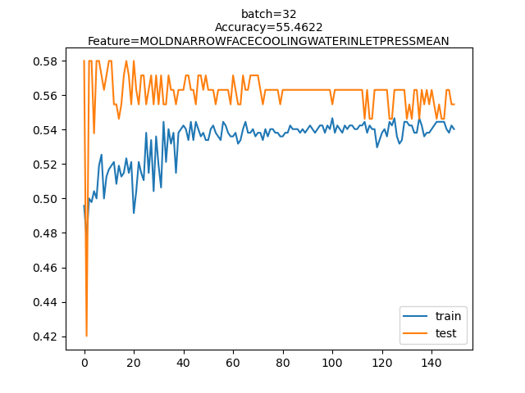
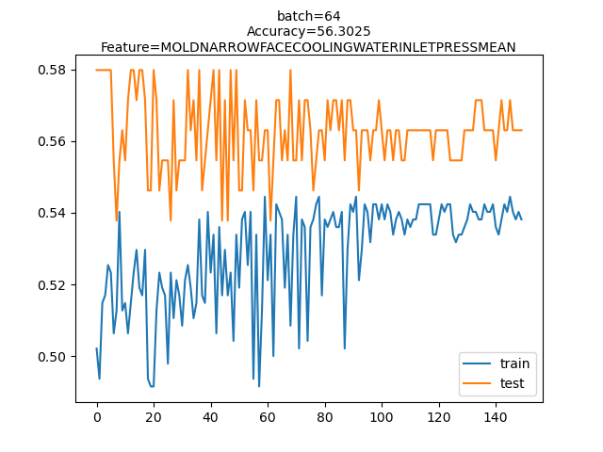
Artificial Neural Network
Analysis of Stability and Convergence of Training Neural Networks With Different Batch Sizes.

Slide 5
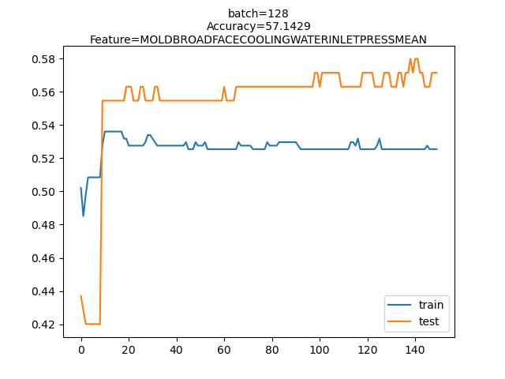
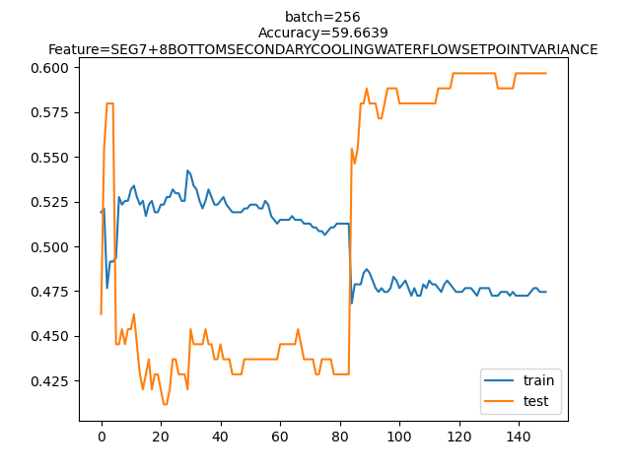
Artificial Neural Network
Analysis of Stability and Convergence of Training Neural Networks With Different Batch Sizes.

Slide 6
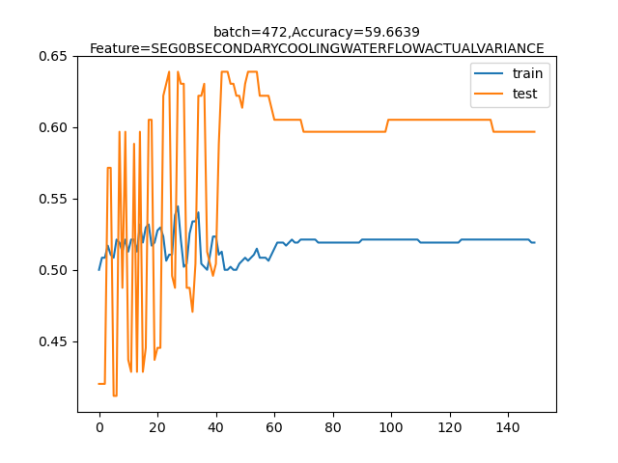
Artificial Neural Network
Analysis of Stability and Convergence of Training Neural Networks With Different Batch Sizes.

Slide 7
Artificial Neural Network
Analysis of Stability and Convergence of Training Neural Networks With Different Batch Sizes.
Batch Size | First Statistical Feature Selected in Forward Selection Algorithm | Accuracy
32 | MOLD NARROW FACE COOLING WATER INLET PRESS MEAN | 55.46%
64 | MOLD NARROW FACE COOLING WATER INLET PRESS MEAN | 56.30%
128 | MOLD BROAD FACE COOLING WATER INLET PRESS MEAN | 57.14%
256 | SEG 7+8 BOTTOM SECONDARY COOLING WATER FLOW SET POINT VARIANCE | 59.66%
472 | SEG 0B SECONDARY COOLING WATER FLOW ACTUAL VARIANCE | 59.66%

Slide 8
Artificial Neural Network
Best configuration choice for the base model features that come from the intersection of the top 20 features in the decision tree and random forest algorithm.
Type of Scaler | Regularization | Types of Batch Size | Type of Optimizer | Train Accuracy | Test Accuracy
Robust Scaler | L1(0.01) | Mini Batch Gradient Descent (batch size=5) | Adam | 68.01% | 57.98%
Robust Scaler | L2(0.01) | Mini Batch Gradient Descent (batch size=5) | Adam | 71.4% | 64.71%
Standard Scaler | L2(0.01) | Mini Batch Gradient Descent (batch size=5) | Adam | 74.79% | 65.55%
Minmax Scaler | L2 (0.01) | Mini Batch Gradient Descent (batch size=5) | Adam | 51.91% | 47.06%
Robust Scaler | L2 (0.01) | Batch Gradient Descent (batch size=len(trainX)) | Adam | 71.61% | 67.23%
Robust Scaler | L2 (0.01) | Batch Gradient Descent (batch size=len(trainX)) | rmsprop | 68.86% | 66.39%
Robust Scaler | L2 (0.01) | Batch Gradient Descent (batch Size=len(trainX)) | SGD(momentum=0.9) | 72.88% | 71.43%
Robust Scaler | L2 (0.01) | Stochastic Gradient Descent (batch Size=1) | SGD(momentum=0.9) | 48.09% | 47.06%
Note: The condition for the output column has been changed and code reproducibility has been resolved.

Slide 9
Artificial Neural Network
Case Study 1
Forward Selection Algorithm.
Statistical Features obtained after running the forward selection algorithm on the base model features being intersecting features from the random forest and decision tree algorithm.
Base Statistical Features Selected for Forward Selection Algorithm
NARROW FACE SECONDARY COOLING WATER PRESSURE ACTUAL MEAN
MOLD BROAD FACE1 INLET OUTLET WATER TEMP. DELTA MEAN
STEEL LEVEL IN MOLD-SET MEAN
SEG 0B SECONDARY COOLING WATER PRESSURE ACTUAL MEAN
SEG 9+10+11+12 BOTTOM SECONDARY COOLING WATER FLOW ACTUAL MEAN
LIQUIDUS TEMP MEAN
NARROW FACE1 WATER FLOW MEAN
TUNDISH WEIGHT MEAN

Slide 10
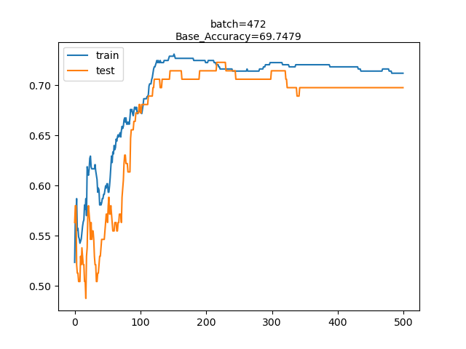
Artificial Neural Network
Case Study 1
Forward Selection Algorithm.
The optimal feature set obtained after forward selection algorithm is same as the base feature set with the recorded accuracy of 69.74%.

Slide 11
Artificial Neural Network
Case Study 2
Forward Selection Algorithm.
Statistical Features obtained after running the forward selection algorithm starting with an empty set of features.
Statistical Features Selected from Forward Selection Algorithm | Corresponding increase in accuracy
BROAD FACE 2 WATER FLOW VARIANCE | 57.98%,
SEG 9+10+11+12 TOP SECONDARY COOLING WATER FLOW ACTUAL MEAN | 62.18%
NARROW FACE SECONDARY COOLING WATER FLOW ACTUAL MEAN | 63.86%

Slide 12
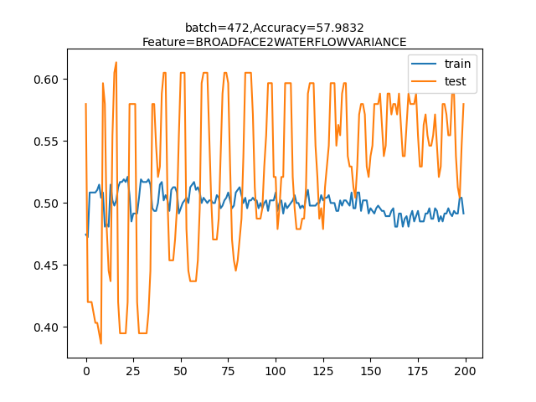
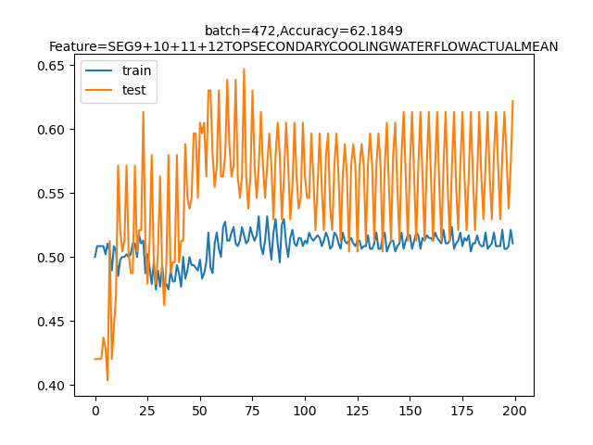
Artificial Neural Network
Case Study 2
Forward Selection Algorithm.

Slide 13
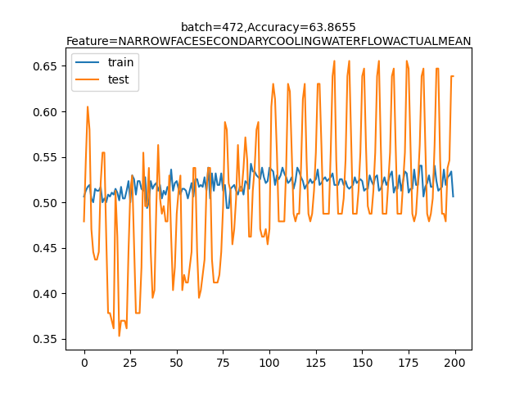
Artificial Neural Network
Case Study 2
Forward Selection Algorithm.

Slide 14
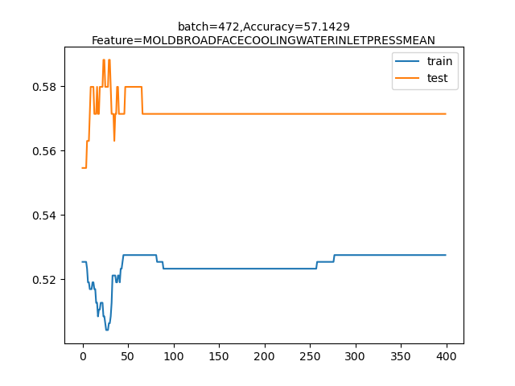
Artificial Neural Network
Case Study 3
Forward Selection Algorithm.
Statistical Features obtained after running the forward selection algorithm starting with an empty set of features.
Statistical Features Selected from Forward Selection Algorithm | Corresponding increase in accuracy
MOLD BROAD FACE COOLING WATER INLET PRESS MEAN | 57.14%

Slide 15
Artificial Neural Network
Case Study 4
Forward Selection Algorithm implemented on Random Forest Classifier.
Statistical Features obtained after running the forward selection algorithm starting with an empty set of features.
Statistical Features Selected from Forward Selection Algorithm | Corresponding increase in accuracy
MOLD OSC FREQ MAX | 59.66%
SPEEDMEAN | 60.5%
PER_SMEAN | 66.38%
SEG 13+14 TOP SECONDARY COOLING WATER FLOW SET POINT MEAN | 69.75%

